Slide 1
VIRTUAL MEMORY
By : Sumit Chauhan(05)
Tushar Rustagi(14)
Prince Yadav(15)
Shubham Kaushik(17)
Ritik Aggarwal(24)
Pranjal Jain(32)
College: Bhagwan Parshuram Institute of Technology (BPIT)
Submitted to : Ms. Kritika

Slide 2
INDEX
Introduction
Address Space And Memory Space
Address Mapping Using Pages
Associative Memory Page Table
Page Replacement

Slide 3
INTRODUCTION
In memory hierarchy system programs, programs and data are first stored in auxiliary memory, portion of program or data are brought into main memory as they are needed by the CPU.
Code needs to be in memory to execute, but entire program rarely used
Entire program code not needed at same time
Virtual memory is concept used in large computer systems that permit user to construct programs as though a large memory space were available.
Consider ability to execute partially-loaded program
Program no longer constrained by limits of physical memory
programs could be larger than physical memory
More processes can be accommodated

Slide 4
Address Space & Memory Space
Address space : An address used by programmer is called virtual address and the set of such addresses is called as address space.
Memory space: An address in main memory is called a location or physical address. Set of such locations is called memory space.
Address space is set of addresses generated by programs as they refer instruction and data.
Memory space consists of actual main memory locations directly addressable for processing.
Address space is allowed to be larger than memory space in computers with virtual memory.

Slide 5
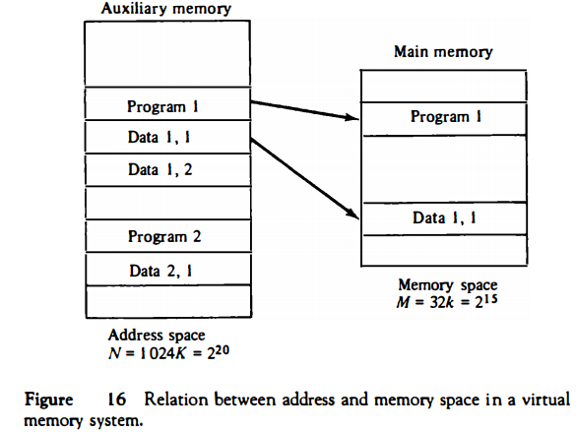
In multiprogram computer system program and data are transferred to and from auxiliary memory and main memory based on demands imposed by CPU.
When program 1 is being executed by CPU ,then program 1 and portion of its associated data are moved from auxiliary memory to main memory as shown in the figure.

Slide 6
In virtual memory, programmers are told that they have total address space available.
Instruction code has sufficient number of bits to specify all virtual addresses.
CPU references instructions and data with a 20-bit address but the information at this address must be taken from physical memory.
A table is then needed to map a virtual address of 20 bit to a physical address of 15 bits.
Mapping is dynamic operation, which means that every address is translated immediately the CPU.
Mapping table may be stored in separate memory or in main memory.

Slide 7
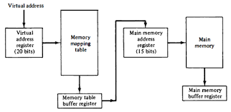
If mapping table is stored in separate memory, an additional memory unit will be required as well as one extra memory access time.
If it is stored in main memory, then table takes space from main memory and two access memory are required with program running at half speed.
Third alternatives to use an associative memory.

Slide 8
Address mapping using Pages
The table implementation of the address mapping Is simplified if the information in the address space and the memory space are each divided into groups of fixed size.
The physical memory is broken down into groups of equal size called blocks, which may range from 64 to 4096 words each.
The term page refers to group of address space of the same size.
Page refers to the organization of address space, while a block refers to the organization of memory space.
Term “page frame” is also used to denote a block.

Slide 9
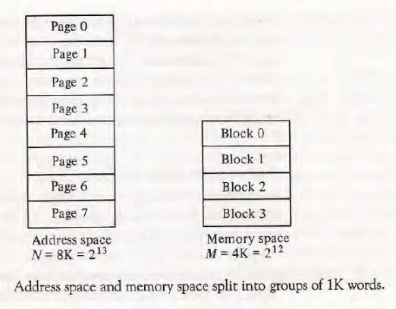
In this example, a virtual address has 13 bits. Since each page consists 2¹⁰ =1024 words, the high order 3 bits of the virtual address will specify one of the eight pages and the low order 10 bits give the line address within the page.
Consider a computer with address space of 8K and a memory space of 4K. If we split each into groups of 1K words we obtain 8 pages and 4 blocks. At any given time, up to four pages of address may reside in main memory in any one of the four blocks.
The mapping from address space to memory space is facilitated if each virtual address is considered to be represented by two numbers: a page number address &a line within the page.
In a computer with 2^{p} words per page, p bits are used to specify a line address and the remaining high order bits of the virtual address specify the page number.

Slide 10
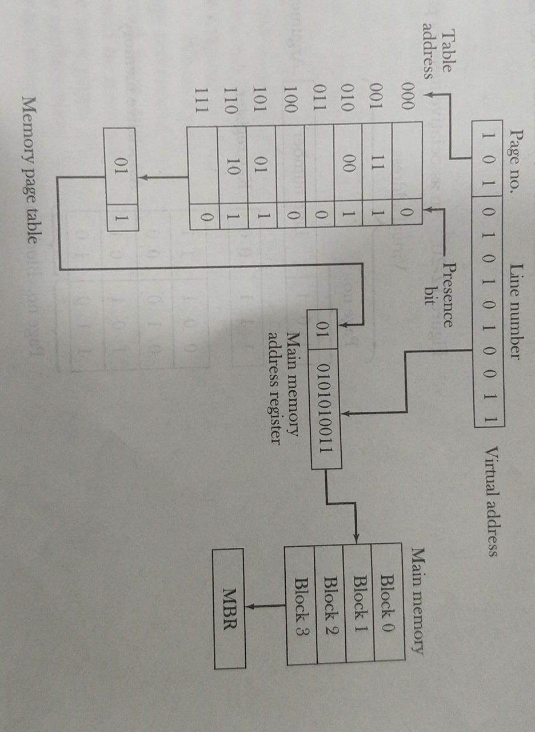
The organisation of the memory mapping table in a paged system

Slide 11
The memory page table consists of eight words, one for each page.
The address in the page table denotes the page number and the content of the word gives the block number where that page is stored in main memory.
A presence in bit in each location indicates whether the page has been transferred from auxiliary memory into main memory.
The three high-order bits of virtual address specify a page number and also an address for the memory page table.
The content of the word in the memory page table at the page number address is read out into the memory table buffer register.

Slide 12
The line number from the virtual address is transferred into the 10 low order bits of the memory address register.
A read signal to main memory transfers the content of the word to the main memory buffer register ready to be used by the CPU.
If the presence bit in the word read from the page table is 0, it signifies that the content of the word referenced by the virtual address does not reside in the main memory.
A call to OS is then generated to fetch the required page from the auxiliary memory and place it into main memory before resuming computation.

Slide 13

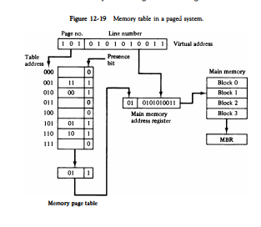
Why we need associative memory page table-
To overcome the inefficiency of random-access memory page table.
As it is inefficient with respect to storage utilization, as we can conclude this from the figure
eight words of memory are needed, one for each page, but at least four words will always be marked empty because main memory cannot accommodate more than four blocks. In general, a system with n pages and m blocks would require a memory-page table of n locations of which up to m blocks will be marked with block numbers and all others will be empty.

Slide 14
consider an address space of 1024K words and memory space of 32K words. If each page or block contains 1K words, the number of pages is 1024 and the number of blocks 32. The capacity of the memory-page table must be 1024 words and only 32 locations may have a presence bit equal to 1. At any given time, at least 992 locations will be empty and not in use.

Slide 15
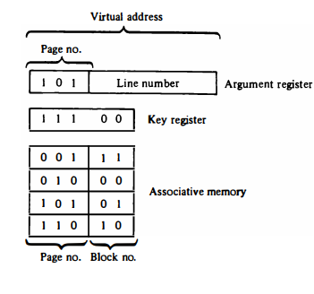
A more efficient way to organize the page table would be to construct it with a number of words equal to the number of blocks in main memory. In this way the size of the memory is reduced and each location is fully utilized.

Slide 16
This method can be implemented by means of an associative memory with each word in memory containing a page number together with its corresponding block number. The page field in each word is compared with the page number in the virtual address. If a match occurs, the word is read from memory and its corresponding block number is extracted.
Considering the case of eight pages and four blocks. We take an associative memory of four words. Each entry in the associative memory array consists of two fields. The first three bits specify a field for storing the page number. The last two bits constitute a field for storing the block number. The virtual address is placed in the argument register. The page number bits in the argument register are compared with all page numbers in the page field of the associative memory. If the page number is found, the 5-bit word is read out from memory. The corresponding block number, being in the same word, is transferred to the main memory address register. If no match occurs, a call to the operating system is generated to bring the required page from auxiliary memory.

Slide 17
Page Replacement
When a program starts execution, one or more pages are transferred into main memory and the page table is set to indicate their position. The program is executed from main memory until it attempts to reference a page that is still in auxiliary memory and this condition is called PAGE FAULT.
When page fault occurs, the execution of the present program is suspended until the required page is brought into main memory.
Generally two of the most common replacement algorithms used are the first in,first out(FIFO) and the least recently used(LRU).
FIFO algorithm selects for replacement the page that has been in memory the longest time. The fifo replacement policy has the advantage of bieng easy to implement. It has disadvantage that under certain circumstances pages are removed and loaded from memory too frequently.

Slide 18
LRU- The LRU is more difficult to implement but has been more attractive on the assumption that the least recently used page is a better candidate for removal than the least recently loaded page as in FIFO. The LRU algorithm can be implemented by associating a counter with every page that is in main memory.
Question: What happens when the page fault occurs in a virtual memory system?
Ans: It signifies that the page refrenced by the cpu is not in the main memory. A new page is then transferred from auxiliary memory to main memory. If main memory is full it removes a page from a memory block to make room for the new page.

Slide 19
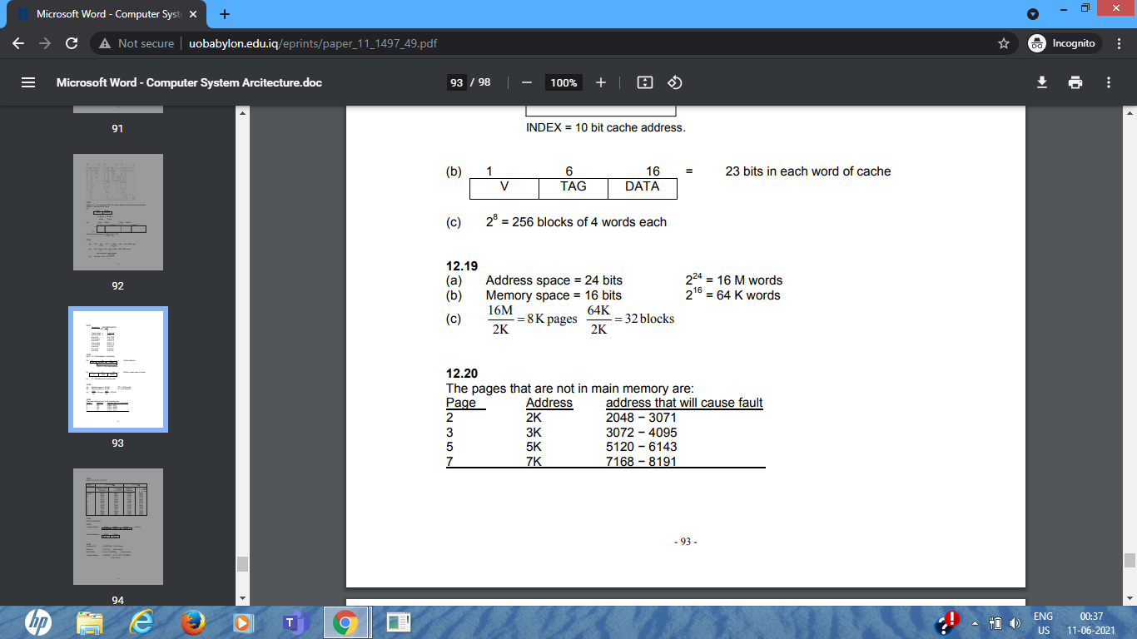
Questions:
Q- An address space is specified by 24 bits and the corresponding memory space by 16 bits
How many words are there in the address space.
How many words are there in the memory space.
If a page consists of 2K words, how many pages and blocks are there in the system?
Answer:
Q- A virtual memory has a page size of 1K words. There are eight pages and four blocks. The associative memory page table contains:
Page Block
0 3
1 1
4 2
6 0
Make a list of all virtual addresses that will cause a page fault if used by the CPU.
Answer:

Slide 20
THANK YOU

